Slide 1
IPO Readiness
June 2024

Slide 2
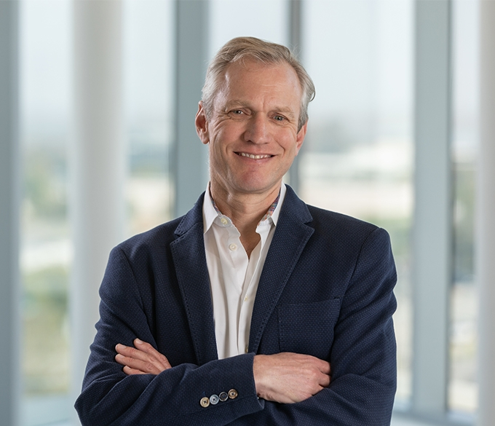
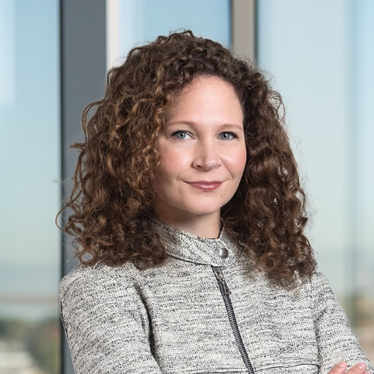
Speakers
JEFF VETTER Chair of Public Companies
Silicon Valley jvetter@gunder.com +1 650 321 2400
ALEXA BELONICK Partner
San Francisco abelonick@gunder.com +1 650 321 2400
ANDY THORPE Partner
San Francisco athorpe@gunder.com +1 650 321 2400

Slide 3
Preparing for an IPO 18-24 months out
Start of IPO Preparation
Org Meeting
IPO
18 to 24 Months Before IPO
12 to 18 Months Before IPO
6 to 12 Months Before IPO
Final 6 Months Before IPO
Auditing & Accounting Matters
Board Matters
Team Composition
Equity Compensation
Governance
Updates to Policies, Processes & Systems
Preparing for IPO Diligence
Refine the Business Story
S-1 Preparation
Equity Compensation
Communications
Investment Bankers & Analysts
Diligence
Testing-the-Waters Meetings
SEC Filings and SEC Review
Roadshow
Pricing & Closing of the IPO

Slide 4
18 to 24 months before the IPO
Auditing & Accounting Matters:
Audited annual financial statements – need 2-3 years audited at the PCAOB-level
Quarterly and interim financial statements – may need trailing eight quarters in IPO S-1 for marketing
Acquisitions – may require separate stand-alone audited financial statements of recently acquired companies (or even probable acquisitions) if the acquisition is “significant”
BOARD Matters:
Prepare for transition from a private company to public company style board
Consider skills, independence and diversity and potential director recruiting needs
Consider implementing one or more of public-company-style committees now (most commonly, audit and compensation committees)
Evaluate risk management oversight

Slide 5
Risk Management
a business & operational Topic for management
A governance Topic FOR board oversight
ERM matrix
Risk management policies, procedures and response plans (training, testing)
Integration of risk management into strategic decision-making
“Tone at the top”
Active, engaged board (including committee) oversight of corporate risk
Cadence of periodic updates (assessments, incidents, mitigation)
Appropriate records of board oversight
Board oversight of risk management

Slide 6
18 to 24 months before the IPO (cont’d)
Team composition:
Senior management – critical functional areas covered and working together for some time before org meeting
Sales and finance functions ready for tyranny of quarterly results and ability to forecast and project earnings
Other critical roles – legal and HR department heads in place to support IPO and post-IPO compliance, IR, IT, internal stock administrator
Outside advisors – accounting/SOX consulting firm, IR preparedness firm, compensation consultant
Equity compensation:
Consider transitioning to quarterly cadence for 409A valuations
Evaluate securities law exemptions and compliance (e.g., Rule 701)

Slide 7
12 to 18 months before the IPO
Governance:
Consider appropriateness of multi-class share structure
Consider any pre-IPO director recruitment needs
Updates to policies, processes and systems:
Document management and internal controls
Communications and metrics
Finance & Accounting
Compliance
Equity Compensation
Human Resources
IP, Commercial Contracts & Privacy

Slide 8
6 to 12 months before the IPO
Refine the business story – effective positioning will be critical for a successful transaction; message should be consistent across platforms
S-1 preparation – assess internal bandwidth to help with early S-1 preparation. Consider sketching out key sections of the S-1 disclosure – particularly the description of the business – before the org meeting
Sustainable
Competitive
Advantage
Customer
Purchase
Decisions Based
on Economic
Value
Proposition
Aftermarket
Performance
Dependent
on Ability to
Execute
Demonstrable
Customer Wins
Positioned to Benefit
from Global
Macro Trends
Value Enhancing
Use of Proceeds
Attractive Return
on Capital Invested
in the Business
Large
Addressable
Market Poised for
Product Adoption
Strong and
Experienced
Management Team
with a Proven
Track Record

Slide 9
6 to 12 months before the IPO
Prepare for IPO diligence:
Underwriters typically request records for at least past three fiscal years (in addition to backup and participating in due diligence calls with management, auditors, and sometimes key customers/partners)
Areas of focus depend on the company’s industry, include cybersecurity, regulatory/IP/legal, privacy and data security
Equity Compensation:
Identify executive officers and Section 16 officers, assess changes to compensation and underlying documentation
Consider how to address RSUs or options nearing their expiration
Check for loans to executive officers
Consider change in 409A valuation methodology (e.g., PWERM) and check for “cheap stock” issues

Slide 10
6 to 12 months before the IPO
Communications:
Begin practicing coordination around communications (e.g., legal review of press releases, checking calendar of presentations against IPO process milestones)
Practice timely quarter closes and mock earnings calls
Investment Bankers & Analysts:
Identify bankers that understand market conditions, the company’s business and its industry (in a traditional IPO, investment bankers help position the company in the market and build a market for the shares offered)
Think about the group of analysts that will cover the business after the IPO; coordinate with underwriters on holding analyst days ahead of the IPOs
“Road test” investment backs, for by working with them to prepare/refine the company’s investor deck for non-deal roadshows or holding testing the waters meetings with investors

Slide 11
Thank You!
Please contact us with any questions:
insights@gunder.com

